Slide 1



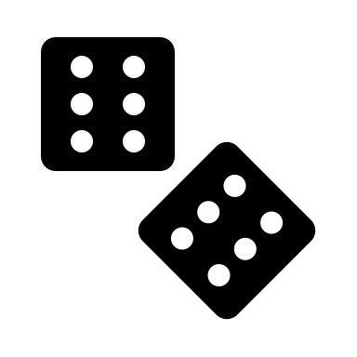


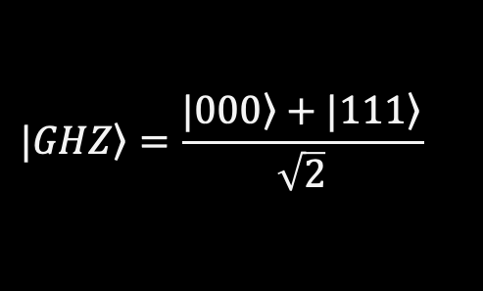
GHZ-Game
Using Quantum Entanglement to escape from an evil wizard…
$$\left.|GHZ\right\rangle =\frac{\left.|000\right\rangle +|\left.111\right\rangle }{\sqrt{2}}$$

Slide 2



Rules – Setup (1/3)
Color
The three of you are getting locked in different rooms by a wizard.
He gives each of you a piece of paper asking either for a color or for a shape.
Shape
Example
Shape

Slide 3
Rules – Setup (2/3)
Color
Color:
or
If asked for a color you can write red or blue on the paper, if asked for a shape you can chose either a star or a square.
You have until midnight to chose your answer.
You do not know what your friends were asked and have no possibility to communicate, but you are allowed to agree upon a strategy beforehand.
Shape
Shape:
or
Shape
Shape:
or

Slide 4
Rules – Setup (3/3)
Shape
Color
Shape
Color
Shape
The wizard will either ask all of you for a color or 2 for a shape and 1 for a color.
Color
Case II
Color
3 possible permutations
Case I
Shape
Color
Color
Shape
Shape

Slide 5
Rules – Winning Conditions
Case I
Case II
a)
a)
Depending on the question you were asked, you‘ll win against the wizard if one of the following conditions are met.
b)
(*)
(*)
b)
c)
When asked for 3x color an even number of people needs to answer with red.
When asked for 2x shape and 1x color an uneven number of people needs to answer with red or star.
(*)Permutations of the combinations allowed

Slide 6

Is there a pre-agreed winning strategy?
As you want to win the game, the three of you agree with the strategy shown on the left.
But you quickly recognize that the third asked player has the problem that he/she doesn‘t know what the others were asked.
If they were asked color he/she needs to answer blue, but if they were asked shape his/her answer must be red.
Let‘s say you pre-agreed the third player should always answer with red – then you‘d win just in 3/4 cases.
Thus the probability to win with that strategy is 75% and you wonder if there is a chance to find another one with 100% winning probability…
Sample strategy
Color or shape?
Color or shape?
Color
or

Slide 7
Mathematical approach to find a pre-agreed 100% winning strategy
A, B, C are the three players:
X is color
Y is shape
To satisfy the winning conditions of the GHZ game, the following equations must be true:
When multiplying equations 2, 3, and 4:
As you recognize from the mathematical proof there isn‘ t any chance to find a 100% winning strategy.
You have already found the best one with just 75% winning probability.
X_{A} (Y_{A})² X_{B} (Y_{B})² X_{C} (Y_{C})² = 1
since 1² = (-1)² = 1
Y² is always positive
X_{A}, X_{B}, X_{C},
Y_{A}, Y_{B}, Y_{C}
All color, even number of red or star
Variables:
X_{A} X_{B} X_{C} = -1
X_{A} Y_{B} Y_{C} = 1
Y_{A} X_{B} Y_{C} = 1
Y_{A} Y_{B} X_{C} = 1
One player asked for color (X) others for shape (Y), requirement: uneven number of 1, therefore even number of -1
Each can take on the value:
1
or
-1
X_{A} X_{B} X_{C} = 1
This equation cannot be satisfied if equation 1 is true
Corresponds to red or star
Corresponds to blue or square
Thus it‘ s impossible to win in all cases
(*) Terms were changed to simplify proofing

Slide 8
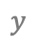
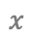
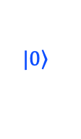

Quantum Solution – Qubits
Thinking and discussing about how to win against the wizard, one of you (a quantum physicist :-) finds a surprising solution to that problem which guarantees a correct answer in all cases.
$$z$$
$$\left.|0\right\rangle$$
Each of you will get a qubit that has been specifically prepared, which we will learn about later. A qubit can be illustrated as a little sphere (the so called Bloch Sphere) with a vector pointing in one direction, that describes the state of the qubit.
$$y$$
$$x$$
$$\left.|1\right\rangle$$

Slide 9
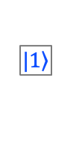
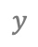
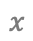
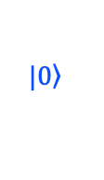
Quantum Solution – Qubits
$$z$$
$$\left.|0\right\rangle$$
However, you cannot see or measure in which state the qubit is exactly. The result of a measurement is always either 0 or 1, which only reveals partial information about the exact state. It is random which of the results 0 or 1 you get. In this specific case (when the state vector points to the equator of the sphere), the measurement result will be 0 or 1 each with 50% probability.
$$y$$
$$x$$
$$\left.|1\right\rangle$$
0
1
We encode (translate) the shape and color of the objects in the following way: answer with blue or square whenever the result of the measurement of your qubit is 0, and accordingly with red or star when the result of the measurement is 1.

Slide 10



Quantum Solution – Entanglement
To get the correct answers for all cases the qubits need to be entangled, which means they have a strong dependency. Therefore, their states cannot be described individually but only in a correlated manner.
The fascinating thing is, each qubit when observed individually, behaves perfectly random. But when considering the whole system a dependency becomes obvious.
Thinking about that, one of you wonder if that is against the rule to not communicate with each other after the question was asked.
But quantum mechanics tell us: It isn‘t – because the qubits do not communicate, they are just correlated in such a way that they cannot be seen as independent.

Slide 11
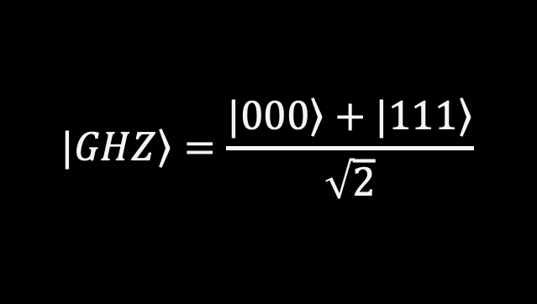
Quantum Solution – GHZ State
Before you start you need to bring all your three qubits into the so-called GHZ-State. This is an entangled state that creates dependencies between the qubits.
$$\left.|GHZ\right\rangle =\frac{\left.|000\right\rangle +|\left.111\right\rangle }{\sqrt{2}}$$
To create the GHZ state, you can apply the Quantum circuit on the left.
The first gate is the H-gate which brings the qubit into a Superposition. When measured it has a 50% probability of beeing 0 or 50% probability of beeing 1.
The other gates are CNOT-gates operating on 2 qubits. The qubit with the dot is the control qubit and the other one with the cross sign is the target qubit. Basically this means, if the control qubit is 1 an X-gate is applied to the target qubit. Otherwise nothing happens.

Slide 12
Quantum Solution – Measuring in different basis
As the wizard asked for two different properties (aspects), we can imagine these to correspond to different basis’ of the qubit, which in turn basically correspond to measurements along a different axis. The X axis (or basis) stands for the color and the Y axis (or basis) for the shape.
Imagine a dice to simplify. A quantum computer typically measures in the Z-axis, i.e. the red line through dice. However we need the information about what is on the sides of the dice.
Instead of measuring in the X or Y axis (which quantum computers do not allow directly), we turn the dice with specific gates and then measure in the Z axis.

Slide 13


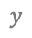
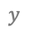
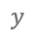
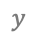
Quantum Solution – Measuring in different basis
Start
$$z$$
Transform to Z-basis
$$z$$
Measure in Z-basis
$$z$$
- Gate
To measure in the X axis (i.e. the color), we first apply an H-gate. It rotates the Bloch sphere and maps the X axis to the Z axis, and thus enables us to read out the X-value.
180° rotate around the Z-axis
90° rotate around the Y-axis
$$y$$
$$y$$
$$y$$
$$x$$
$$x$$
$$x$$
Start
$$z$$
Transform to X-basis
$$z$$
When asked for the shape, an sdg-gate followed by an H-gate will be applied. This combination of gates rotates the Y axis to the Z axis, and thus enables us to read out the Y-value.
- Gate
$$y$$
$$y$$
270° rotate around the Z-axis
$$x$$
$$x$$

Slide 14
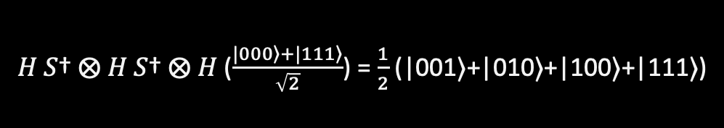
Quantum Solution – Example Circuit and Solution
|001⟩ =
You want to try out this strategy and the wizard asks you for color, shape and shape.
|010⟩ =
|100⟩ =
|111⟩ =
𝐻 𝑆† ⨂ 𝐻 𝑆† ⨂ 𝐻 ($\frac{\left.|000\right\rangle +|\left.111\right\rangle }{\sqrt{2}}$) = $\frac{1}{2}$ (|001⟩+|010⟩+|100⟩+|111⟩)
As you can see – with all combinations you‘ll win against the wizard.
When measuring this state, only one of the four winning combinations on the right can occur as a result, but no other combination of colors and shapes.

Slide 15

Quantum Solution – Example Circuit and Solution
|000⟩ =
Remark: When asked color, color color the following holds.
|011⟩ =
|101⟩ =
|110⟩ =
𝐻 ⨂ 𝐻 ⨂ 𝐻 ($\frac{\left.|000\right\rangle +|\left.111\right\rangle }{\sqrt{2}}$) = $\frac{1}{2}$ (|000⟩+|011⟩+|101⟩+|110⟩)
As you can see – with all combinations you‘ll win against the wizard.
When measuring this state, only one of the four winning combinations on the right can occur as a result, but no other combination of colors.

Slide 16
End of the game
The results for each player seems to be perfectly random, but all three results in fact are strongly correlated and not independent. This is caused by the entanglement.
So using Quantum Mechanics and an entangled GHZ state, you were able to win against the evil wizard – Congrats!

